Slide 1
SupportMyPhone
Mor Hasid – hasid123@gmail.com - 204676332
Tom Zaiger – tomzaiger@hotmail.com- 313579526
Leah Brodsky – leahbr@ac.sce.ac.il- 318191764
Dor Hazout – hazoutdor@gmail.com- 313560328
Group 1
Nati Dadon – djroom@me.com- 201062528
Rotem Goldshtein – rotemgoldshtein@gmail.com- 308577188
Roni Goldsmid – ronigoldsmid@gmail.com- 312146343
Zohar Kahlon – zohar1812@gmail.com- 311530059
START

Slide 2
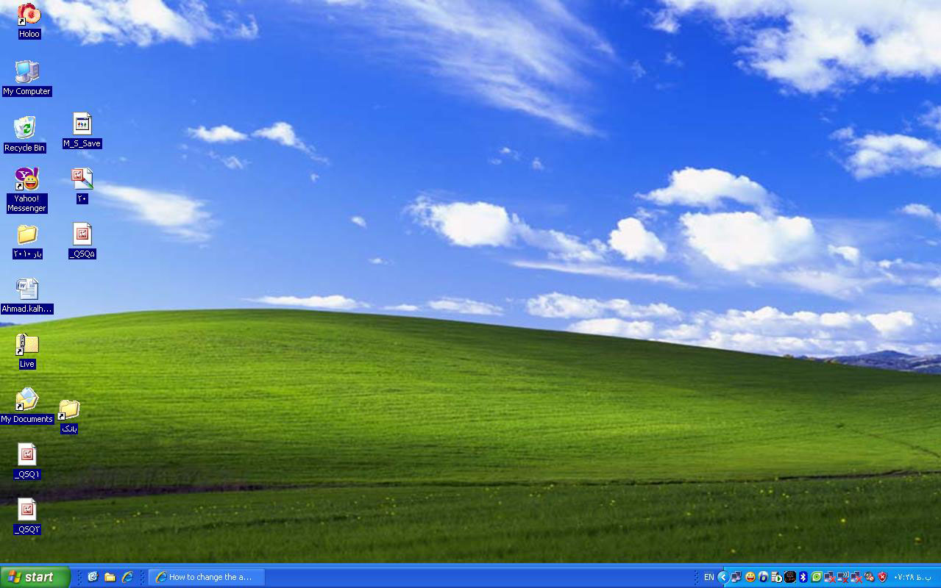
Login screen - Example
Login
Username:
Password:
Tomza1
***********
ENTER

Slide 3
Login screen
Login
Username:
Password:
ENTER

Slide 4
Menu
Change User
Menu
Sorted tickets
New ticket
Analysis system

Slide 5
Sorted tickets
Date | Severity | Status | Customer ID | Ticket number
28\10\2018 | Urgent | Open | 308577188 | 2000018
28\10\2018 | Urgent | Open | 311530059 | 2000037
28\10\2018 | Not urgent | Open | 312146343 | 2000026
28\10\2018 | Urgent | In handling | 318191764 | 2000100
28\10\2018 | Not urgent | Closed | 313579526 | 2000045
Return

Slide 6
Filled ticket example - Rotem
Name: ID:
Phone number: Email:
Problem category:
Problem description:
Date:
Status:
Stakeholder:
Ticket number
Comments\Documents:
Severity:
308577188
Rotem Goldshtein
054-6533665
rot******@gmail.com
Hardware
Screen
Cracked top left corner, not responding.
28/10/18
Open
Technical support
Submit
2000018
No documents.
Return
Urgent

Slide 7
New ticket - Menu
Menu
New contact
Existing contacts
Return

Slide 8
Client search
Contact search
ID Number
313579526
Return
Search

Slide 9
Contact view - Tom
Name: ID:
Phone number: Email:
Tom Zaiger
313579526
050-2566050
t*****@hotmail.com
Date | Severity | Status | Customer ID | Ticket number
28\10\2018 | Not urgent | Closed | 313579526 | 2000045
Return
Add new ticket

Slide 10
Contact view - Tom
Name: ID:
Phone number: Email:
Tom Zaiger
313579526
050-2566050
t*****@hotmail.com
Date | Severity | Status | Customer ID | Ticket number
28\10\2018 | Not urgent | Closed | 313579526 | 2000045
Return
Add new ticket

Slide 11
New ticket – Existing contact
Name: ID:
Phone number: Email:
Problem category:
Problem description:
Date:
Status:
Stakeholder:
Ticket number
Comments\Documents:
Severity:
313579526
Tom Zaiger
050-2566050
t******@hotmail.com
/ /
Submit
Return

Slide 12
Filled ticket example - Tom
Name: ID:
Phone number: Email:
Problem category:
Problem description:
Date:
Status:
Stakeholder:
Ticket number
Comments\Documents:
Severity:
313579526
Tom Zaiger
050-2566050
t******@hotmail.com
Hardware
Battery
Phone got wet, doesn’t turn on.
18/10/18
Closed
Technical support
Submit
2000045
No documents.
Return
Not urgent.

Slide 13
New ticket – New contact
Client details
Name: ID:
Phone number: Email:
308577188
Rotem Goldshtein
054-6533665
Rot******@gmail.com
Return
Submit

Slide 14
New ticket – Example
Name: ID:
Phone number: Email:
Problem category:
Problem description:
Date:
Status:
Stakeholder:
Ticket number
Comments\Documents:
Severity:
308577188
Rotem Goldshtein
054-6533665
rot******@gmail.com
/ /
Submit
Return

Slide 15
Contact view - Rotem
Name: ID:
Phone number: Email:
Rotem Goldshtein
308577188
054-6533665
rot*****@gmail.com
Date | Severity | Status | Customer ID | Ticket number
Return
Add new ticket

Slide 16
Analysis system - Menu
Menu
Most common problems
Exceeding contacts
Return

Slide 17
Most common problems
Problems menu
Description | Category | Hardware /Internet
Broken screen | Screen | Hardware
Slow connection | Connection | Internet
Battery running out quickly | Battery | Hardware
Camera not responding | Camera | Hardware
Blocking inappropriate contents | Content | Internet
Return

Slide 18
Problem fix - Example
Block content
Apply children protection->block inappropriate contents
If the problem remains unsolved turn to a local lab.
Enter the phone setting->parent mode
Return

Slide 19
Exceeding contacts
Exceeding contacts-Monthly
Cellular Package offer | Internet package offer | Calls regarding Travel packages | Calls regarding Slow connection | Customer ID
 | X | 0 | 7 | 308577188
 |  | 0 | 5 | 311530059
X | X | 2 | 4 | 312146343
X |  | 3 | 3 | 318191764
 | X | 1 | 3 | 313579526
Return

